Slide 1
MedChi Network Services
An innovative collaborative between physicians and the Maryland medical society.

Slide 2
History of MNS

Slide 3
The Problem
Private practices are struggling more than ever because of a number of new and expanding initiatives:
New payment systems are requiring evermore documentation for quality
Hospitals are expanding with no end in sight
Revenue for independent groups is shrinking

Slide 4
MedChi’s Solution
Focus on supporting independent practices with end-to-end services
Practices are a system – everything needs to work together
Provide resources to practices as businesses not clinics
Physicians are seeing patients, staff are supporting day to day activities – businesses still need strategic plans, capital budgets, training programs, websites…
Develop Accountable Care Organizations (ACOs) and other models that encourage physician collaboration and leadership

Slide 5
Strategic Partnership
MedChi created a joint venture with Health Prime International (HPI) to provide expanded services directly to physicians
Both organizations bring unique strengths to MedChi Network Services (MNS):
Medical Society is the ‘seal of approval’
HPI is the experienced service provider

Slide 6
MNS Mission: To support the Private Practice of Medicine

Slide 7
History of MedChi’s Practice Services
Resources to answer typical practice questions
Sub-recipient to Regional Extension Center to help with EHR transitions
Quickly became largest state-designated Management Services Organization

Slide 8
History of HPI
Founded in 2003 to provide back office business solutions and technology
Investment in infrastructure and human resources allow for a comprehensive suite of services
Currently working with over 1,000 physicians across the country

Slide 9
Helping our Profession
All services include a significant member discount or are offered at cost
For example, the discount for Revenue Cycle Management (billing) is more than the cost of MedChi membership
MNS provides programming and resources back to MedChi
First Thursday webinar series, continuing medical education programs, practice management support

Slide 10
Practice Services
Flexible offerings to support businesses of all sizes
Revenue Cycle Management (billing) is core component
Service thresholds, costs, and outcomes are all at or better than national benchmarks
Other offerings include health IT, marketing, coding, compliance, contact center, transcription, consulting

Slide 11
MNS and Accountable Care

Slide 12
Shared Savings Program Overview
CMS innovation intended to help physicians, hospitals, and other health care providers coordinate care
Incentives are offered to separate entities to work together to reduce the cost of care for the Medicare population
The Medicare Shared Savings Programs will reward savings if participants meet quality measures

Slide 13
Program Requirements
An ACO must have at least 5,000 Medicare beneficiaries
Beneficiaries are assigned based on the location they receive majority of their primary care services
There is no required network or other restrictions
Patients may opt-out
At least 75% of the ACO governing board must consist of health care providers participating within the ACO
ACO must strive to achieve the 3 CMS goals of better patient care, improved population health, and lower costs

Slide 14
Advance Payment ACOs
Shared savings programs take time and money to implement, Advanced Payment helps to cover some upfront and on-going costs
Non-recourse loan available to physician-led, rural ACOs (loan must be repaid with savings or will be forgiven if there is no savings)
Competitive offering with application scoring is based on specific group criteria
ACOs must adhere to spend plan for Advance Payment funds

Slide 15
MNS Accountable Care Organizations
Owner and operator of 3 Medicare Shared Savings Program Advance Payment ACOs
All participants are primary care providers
Competitive program with certain restrictions regarding revenue, participants, and geography
Non-recourse loan to support start-up; must be repaid with savings
Affiliate partner of 4 MSSP ACOs (not advance payment), and looking to work with additional groups

Slide 16
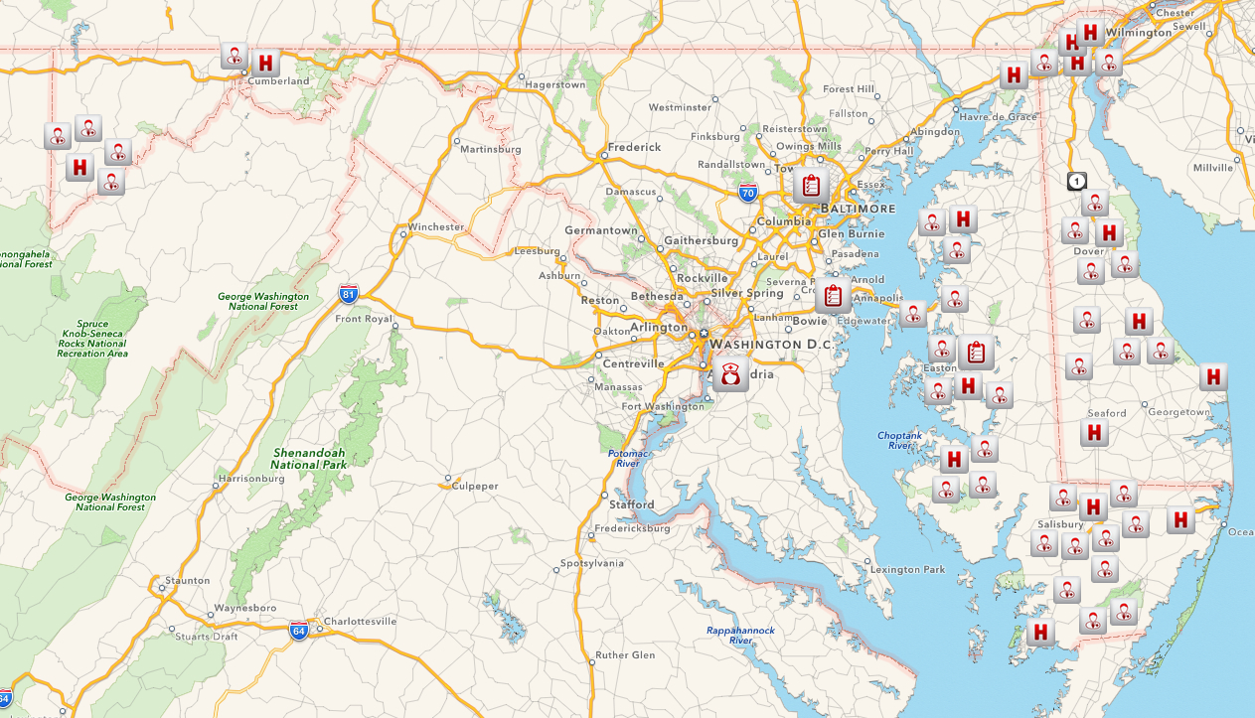
MNS ACO Geography
Western Maryland ACO
- July 2012 start
- 6,000 beneficiaries
- 20 providers
Eastern Shore ACO
- July 2012 start
- 6,500* beneficiaries
- 45 providers
Lower Shore ACO
- January 2013 start
- 10,000 beneficiaries
- 35 providers

Slide 17
Initial Goals and Expectations
Foundation for ACO development:
Avoid overburdening practices
Capture data consistently for analysis and reporting
Share health info safely and effectively
Contribute resources where possible
Quality improvement strategy:
Ensure preventive services are offered consistently
Avoid Emergency Department utilization when possible
Support transitions of care to prevent readmissions

Slide 18
Strategic Focus
Short-term Concerns:
Physicians and staff must be willing to adapt to ACO guidelines and incorporate best practices
IT must securely facilitate data sharing, analytics, and care management
Long-term Concerns:
Patients must take responsibility
ACO must drive value for all stakeholders

Slide 19
Care Coordination Model
Local care coordinators
Chosen from current office staff, charged with day-to-day patient interactions, data recording, and customer service
Central nurse managers
Focus on high-risk subset of the total population, managing telehealth pilots, and building care plans
Robust IT system
Allow real-time data sharing in support of population and individual health management across multiple locations

Slide 20
Current Health IT
Participants at various stages of EHR adoption across multiple platforms
State HIE (CRISP) supports DIRECT messaging and hospital notifications
MNS developed proprietary systems for data warehousing, data exchange
Covisint selected for analytics/risk stratification, user interface, MPI

Slide 21
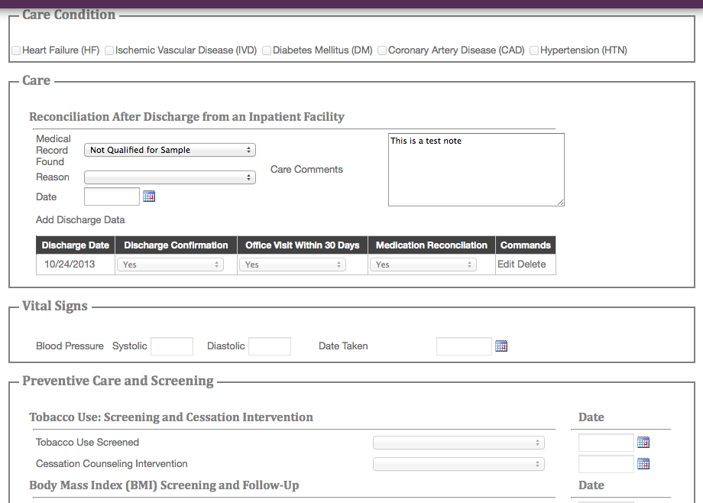
Web Portal
Data gathering at the point of care

Slide 22
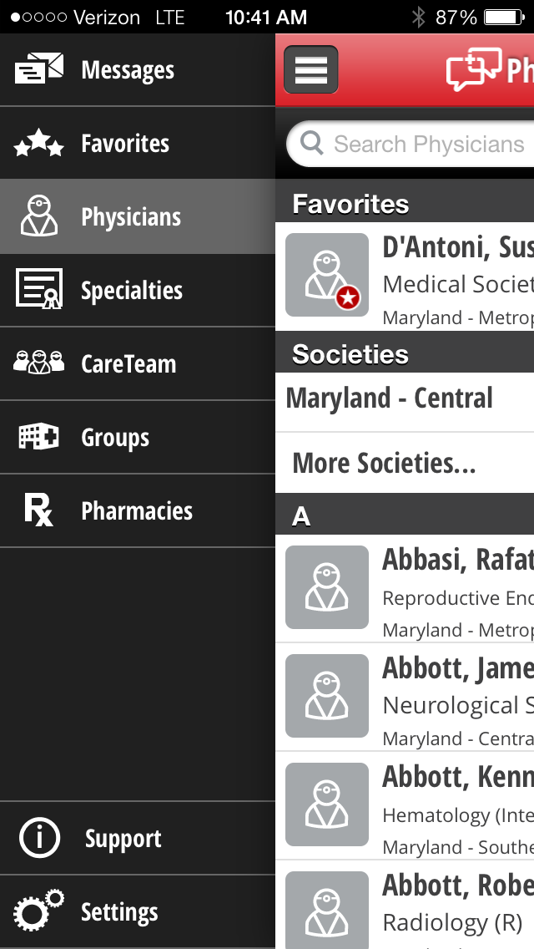
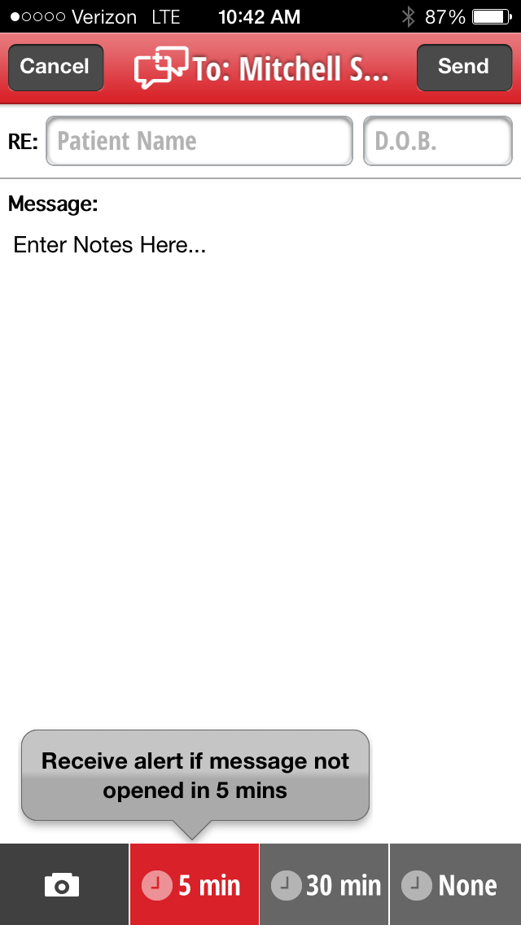
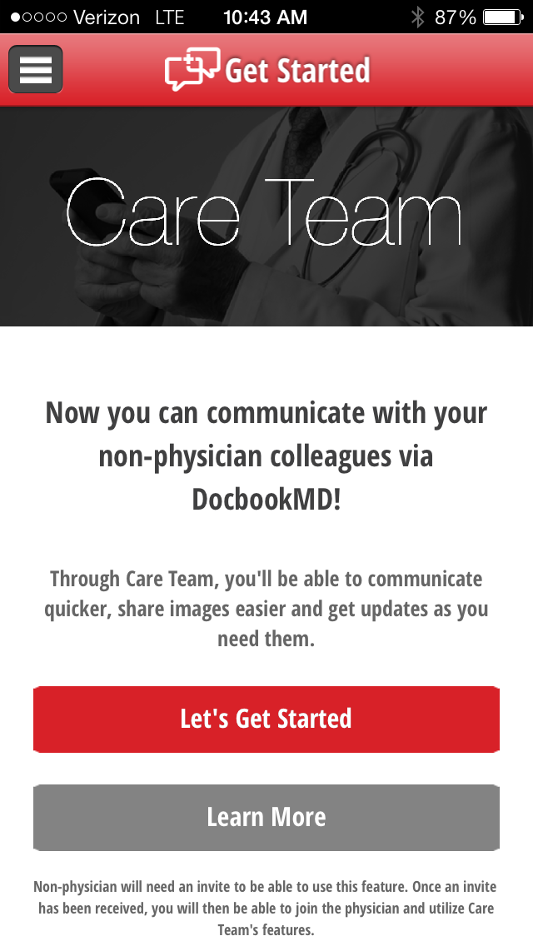
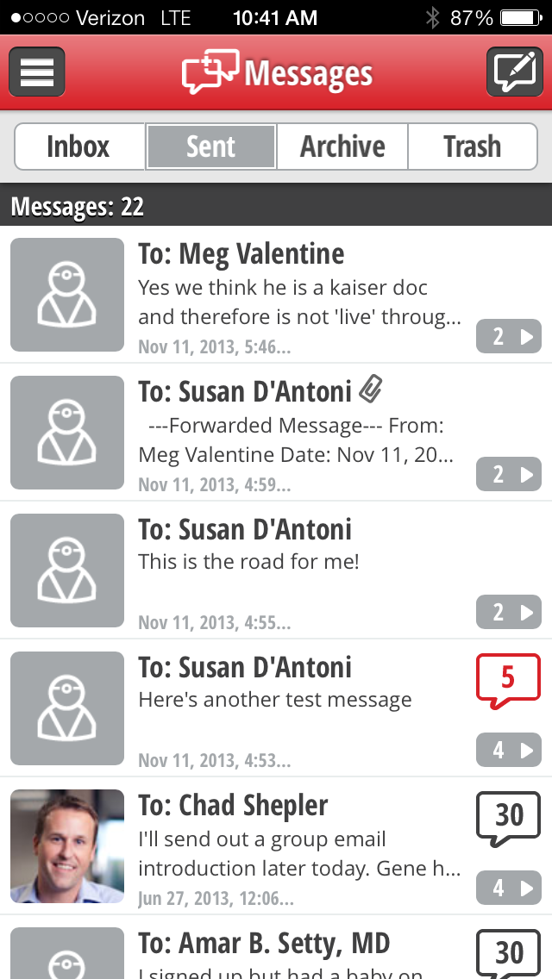
Secure Messaging – DocbookMD

Slide 23
Future of ACOs
Provider Expansion
Additional primary care physicians, specialists, skilled nursing facilities, urgent care centers, hospitals
Payor Expansion
Commercial bundle payment models (PCMH, ACO-like arrangements)
Medicaid ACO pilots
Other innovative care delivery models

Slide 24
Questions? Thank you for joining us here today!
Craig R. Behm
Executive Director
888-507-6024 (office)
410-207-7192 (cell)
cbehm@medchi.org
Parag Shah
Board Chair
301-990-3995 (office)
410-963-5128 (cell)
parag.shah@hpiinc.com

